Slide 1


Slide 2

Introduction
1.KWIC: User inputs alphanumeric data within a specified word limit
2.Circular shift Function
3.Alphabetical Function
4.Function will result in data being displayed, then user will have the option to enter new input or quit the program

Slide 3
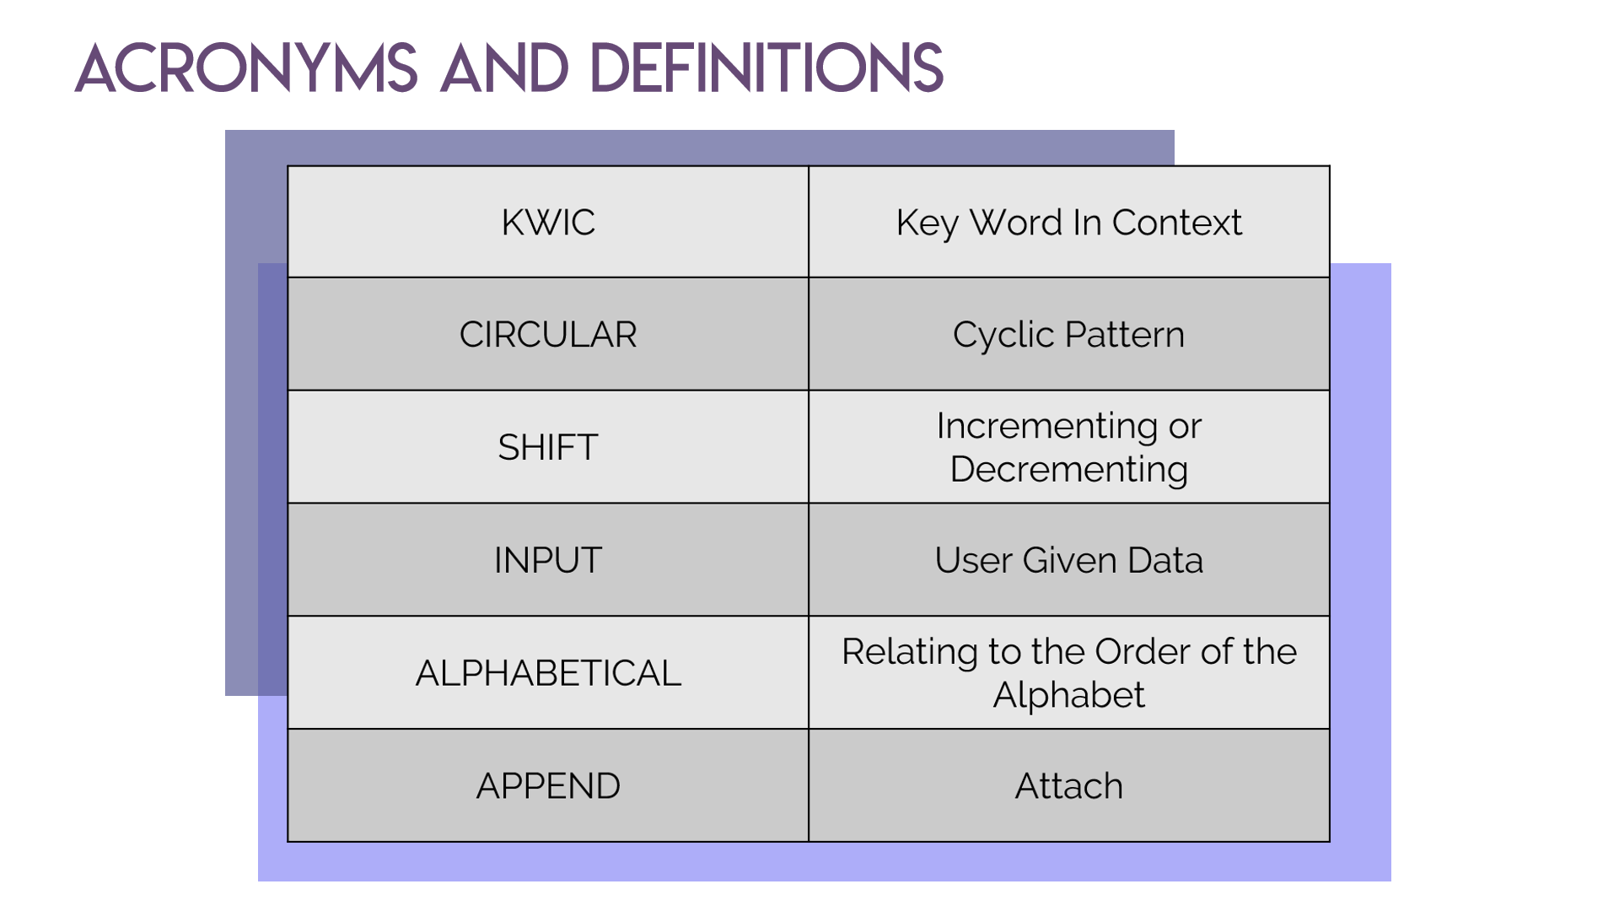

Slide 4

FUNCTIONAL REQUIREMENTS
Application should:
Allow user to enter input
Allow user to perform circular and alphabetical function
Accept no more than one line, 30 words each line
Accept no more than 300 characters per line
Circular shift each line
Output results from circular shift onto display screen
Use result from circular shift as input for alphabetical shift
Output results from alphabetical shift onto display screen
Provide user an option to add more or terminate program

Slide 5

NON-FUNCTIONAL REQUIREMENTS
CONSTRAINTS
Simple/clear
Reusable
Enhanceable
User-friendly
Navigable
Adaptable
portable
EXTERNAL INTERFACE
Must receive data from keyboard
Display results on screen
Options to terminate
mouse/touchscreen
PERFORMANCE
Respond quickly
Efficient
Limited Space
Free space after termination

Slide 6

ARCHITECTURAL SPECIFICATION
Components
1. Input- Received data
2. Master Control- Initiates the program
3. Output- Results to be displayed
5. Circular Shift- Will perform circular shift function on input
6. Alphabetizer- Will alphabetize input
Connections
1. Connection 1: Master Control will call upon Input’s setup function
2. Connection 2: Input will wait for data from the input medium
3. Connection 3: Master Control will call upon Line Storage setup function
4. Connection 4: Master Control will call upon Circular Shift’s setup function

Slide 7
ARCHITECTURAL SPECIFICATION (cont’d)
Connections (continued)
5. Connection 5: Master Control will call upon Alphabetizer’s setup function
6. Connection 6: Alphabetizer will call upon circular shift to receive the input required to perform an alphabetize function.
7. Connection 7: Master Control will call upon Output’s setup and print function.
8. Connection 8: Output will call upon data from Circular Shift and from Alphabetizer
9. Connection 9: Output will send the data, organized, to the output medium.

Slide 8
ARCHITECTURAL SPECIFICATION (cont’d)
Constraints
1. Cannot accept more than 300 characters
2. Cannot accept more than 30 words
3. Program can only accept one line at a time. The user will be prompted
to enter a new line once their original data goes through both functions

Slide 9
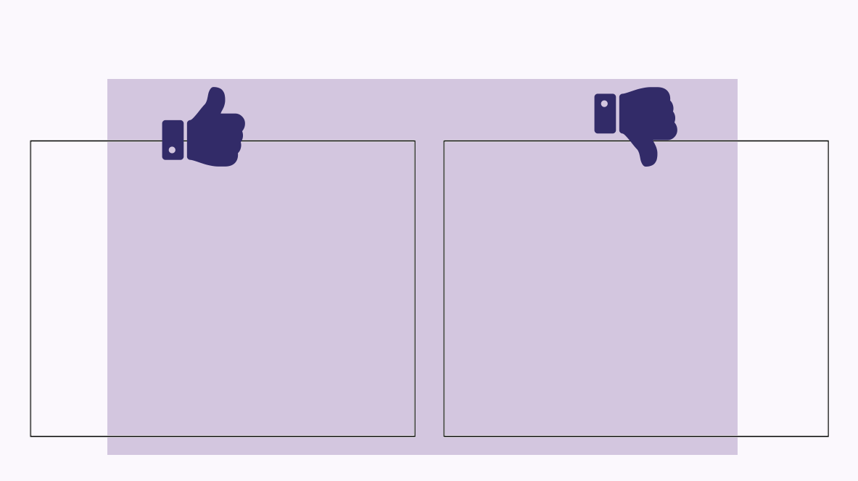
ARCHITECTURAL SPECIFICATION
RATIONALE
-fast performance due to
limitations on input
-one sentence at a time
allows for straightforward
and user-friendly capabilities
-instructions are clear to
basic users
-adaptable
-several constraints that user
needs to be aware of
-character, word, and
sentence limitations
-application does not end
automatically, must be terminated by user

Slide 10
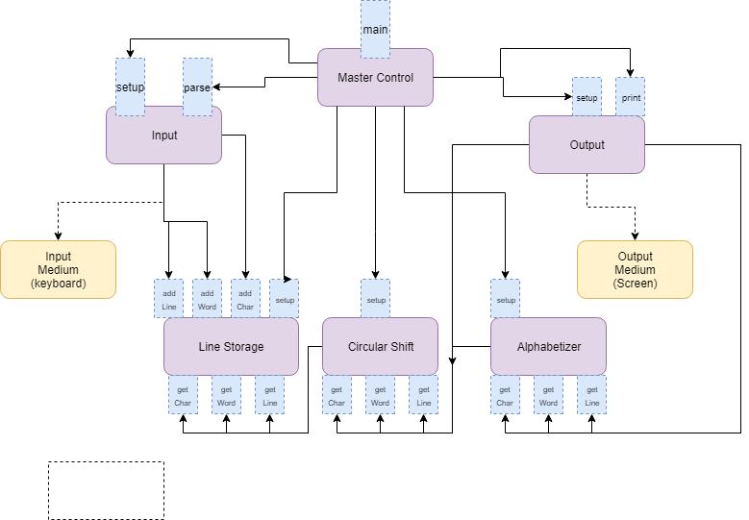
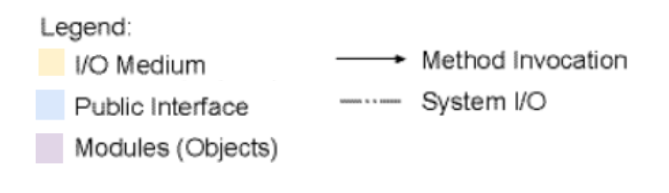
ARCHITECTURE DIAGRAM

Slide 11

1. JAVA APPLET
Implementation of code.
Additional testing will be
performed
2. ARCHITECTURAL DIAGRAM
Research of different
diagrams and comparison
is underway
3. NOISE WORD ELIMINATOR
Has yet to be implemented,
will be used in part 2 of project
WORK IN PROGRESS/
FUTURE WORK

Slide 12
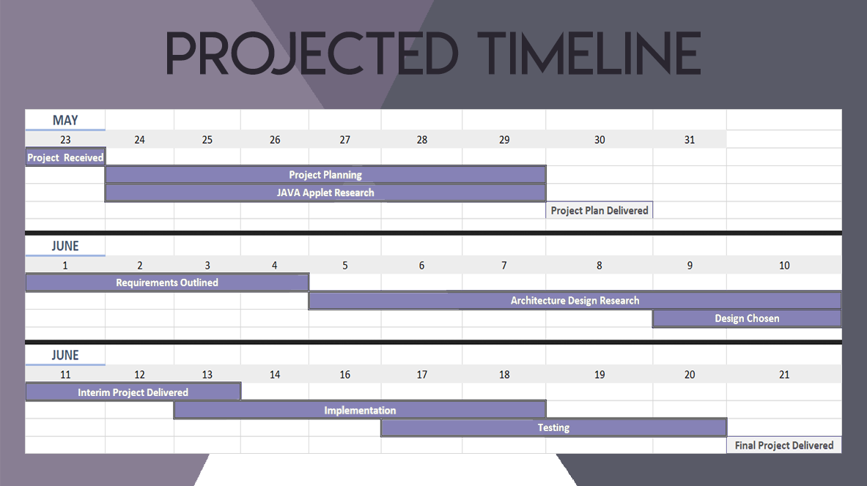

Slide 13
GITHUB:
https://github.com/fareench/CS_4352_Project_1
References
Project Management Plan Template
http://www.utdallas.edu/~chung/SP/SoftwareProjectManagementPlanTemplate.htm
QUESTIONS?

